Slide 1
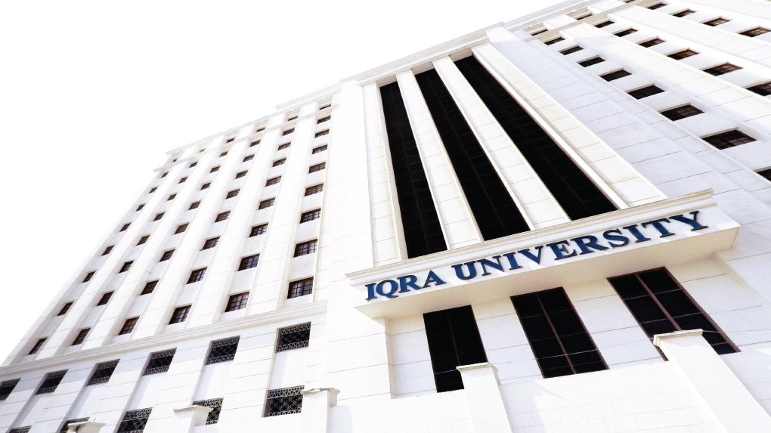

Recurrence Relations
LECTURE 12
Adapted from :
https://www.genrica.com/vustuff/MTH202/MTH202_handouts_1_45.pdf

Slide 2
Learning Outcomes
After completing this lecture satisfactorily, a student will:
• Be able to construct simple mathematical proofs and possess the ability to
verify them.
Have substantial experience to comprehend formal logical arguments.
• Gain experience in using various techniques of mathematical induction
(weak, strong and structural induction) to prove simple mathematical
properties of a variety of discrete structures.

Slide 3
Recursion
A recursive definition (i.e to build the new set elements from the previous one,s) for a set consists of the following three rules:
I. BASE: A statement that certain objects belong to the set.
II. RECURSION: A collection of rules indicating how to form new set
objects from those already known to be in the set.
III. RESTRICTION: A statement that no objects belong to the set other
than those coming from I and II.

Slide 4
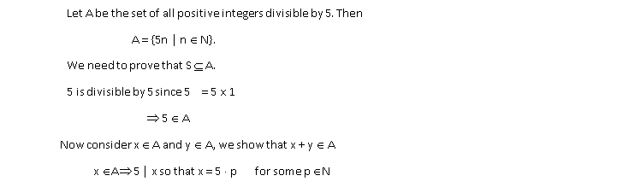
EXERCISE
Let S be a set defined recursively by
I. BASE: 5 ∈ S.
II. RECURSION: If x ∈ S and y ∈ S, then x + y ∈ S.
III. RESTRICTION: S contains no elements other than those obtained from rules I and II.
Show that S is the subset of all positive integers divisible by 5
SOLUTION

Slide 5
RECURSIVE DEFINITION OF BOOLEAN EXPRESSIONS
I. BASE:
Each symbol of the alphabet is a Boolean expression.
II. RECURSION:
If P and Q are Boolean Expressions, then so are
(a) (P ∧ Q)
(b) (P ∨ Q) and
(c) ~ P.
III RESTRICTION:
There are no Boolean expressions over the alphabet
other than those obtained from I and II.

Slide 6
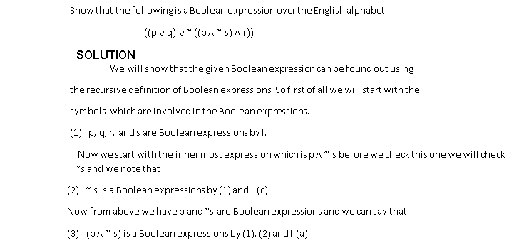
EXERCISE

Slide 7
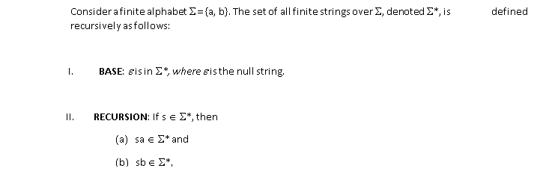
RECURSIVE DEFINITION OF THE SET OF STRINGS OVER AN ALPHABET

Slide 8
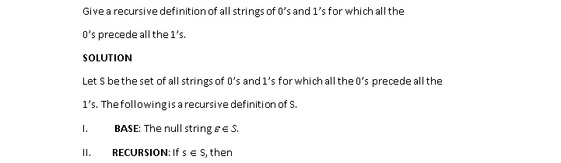
EXERCISE
Give derivations showing that abb is in Σ*.
SOLUTION
(1) ε ∈ Σ* by I.
(2) a = εa ∈ Σ* by (1) and II(a).
(3) ab ∈ Σ* by (2) and II(b).
(4) abb ∈ Σ* by (3) and II(b).
EXERCISE

Slide 9
PARENTHESIS STRUCTURE
Let P be the set of grammatical configurations of parentheses. The following
is a recursive definition of P.
I. BASE: ( ) is in P.
II. RECURSION:
(a) If E is in P, so is (E).
(b) If E and F are in P, so is EF.
RESTRICTION: No configurations of parentheses are in P other than those
derived from I and II above.

Slide 10
EXERCISE

Slide 11
SET OF ARITHMETIC EXPRESSIONS

Slide 12
EXERCISE

Slide 13
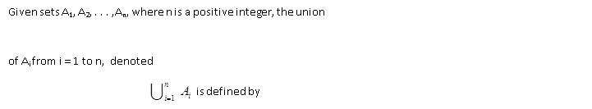
RECURSIVE DEFINITION OF SUM
RECURSIVE DEFINITION OF UNION OF SETS

Slide 14
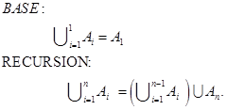
RECURSIVE DEFINITION OF INTERSECTION OF SETS

Slide 15
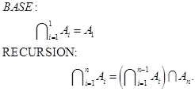

Slide 16
Review Questions
What is RECURSIVE DEFINITION OF THE SET OF STRINGS OVER AN ALPHABET.

Slide 17
Thank you

